Slide 1
Copyright © 2014 Pearson Education, Inc.

Slide 2
Chapter 9
Online Content and Media
Copyright © 2014 Pearson Education, Inc.

Slide 3
YouTube and the Emerging Internet Broadcast System (IBS)
What types of online videos have you watched online, and on what devices?
What sites have given you the best overall viewing or entertainment experience, and why?
What advantages does watching traditional television have over watching online TV and films?
Copyright © 2014 Pearson Education, Inc.
Slide 9-<number>

Slide 4
Online Content
Two major categories
  Print industries
  Online entertainment industries
Generated $15 billion in 2012
Copyright © 2014 Pearson Education, Inc.
Slide 9-<number>

Slide 5
Content Audience and Market
Average American adult spends 4,200 hrs/yr consuming various media
2012 media revenues: $488 billion
Over 77% of the hours spent consuming TV, radio, Internet
2.8 hrs/day on Internet
Internet usage doesn’t reduce TV viewing
Copyright © 2014 Pearson Education, Inc.
Slide 9-<number>

Slide 6
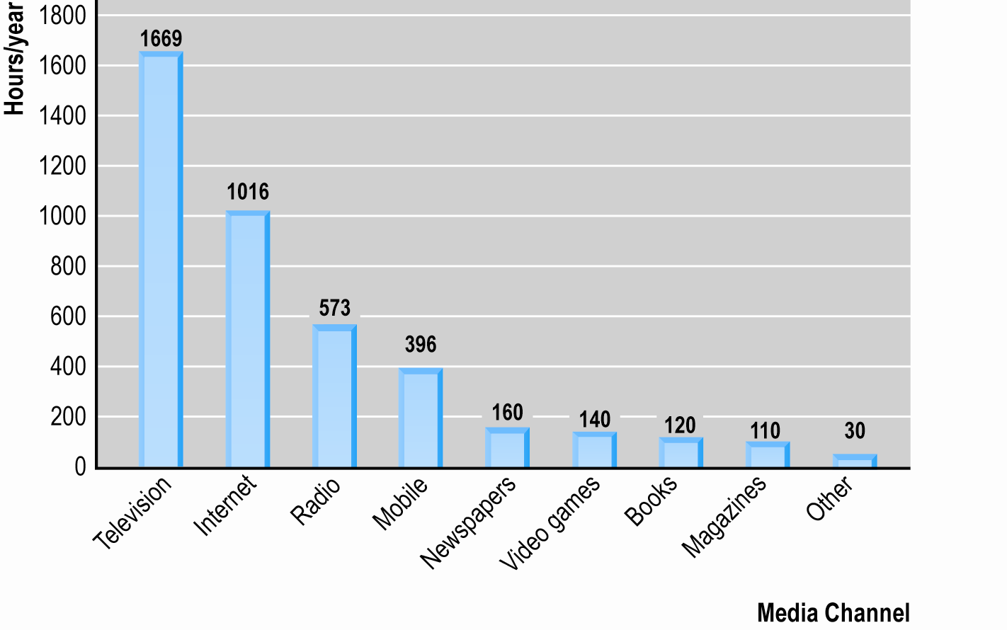
Media Consumption
Figure 9.1, Page 350
SOURCE: Based on data from eMarketer, Inc., 2012a, authors’ estimates
Copyright © 2014 Pearson Education, Inc.
Slide 9-<number>

Slide 7
Internet and Traditional Media
Cannibalization vs. complementarity
  Does time on Internet reduce time spent with other media?
  Books, newspapers, magazines, phone, radio
Internet users
  Spend relatively less time with traditional media
  Consume more media of all types than non-Internet users
Multimedia—reduces cannibalization impact for some visual, aural media
Copyright © 2014 Pearson Education, Inc.
Slide 9-<number>

Slide 8
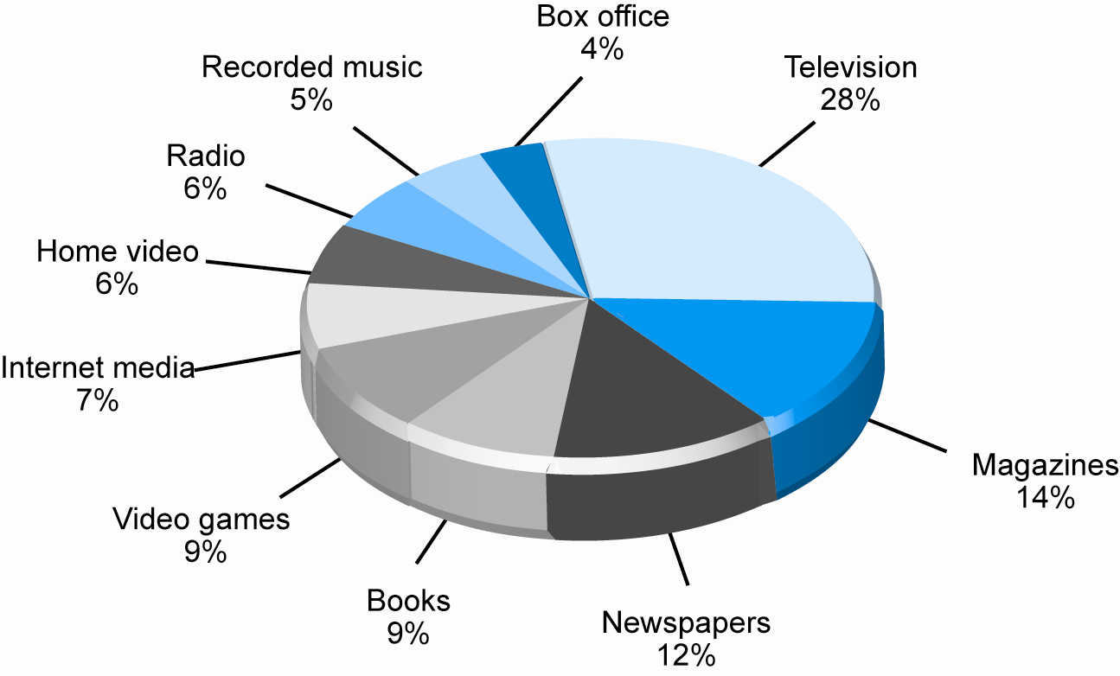
Media Revenues by Channel
Figure 9.2, Page 352
SOURCE: Based on data from industry sources; authors’ estimates.
Copyright © 2014 Pearson Education, Inc.
Slide 9-<number>

Slide 9
Digital Content Delivery Models
Online content delivery revenue models
  Subscription
  A la carte
  Advertising supported (free/freemium)
Free content can drive users to paid content
Users increasingly paying for high-quality, unique content
Copyright © 2014 Pearson Education, Inc.
Slide 9-<number>

Slide 10
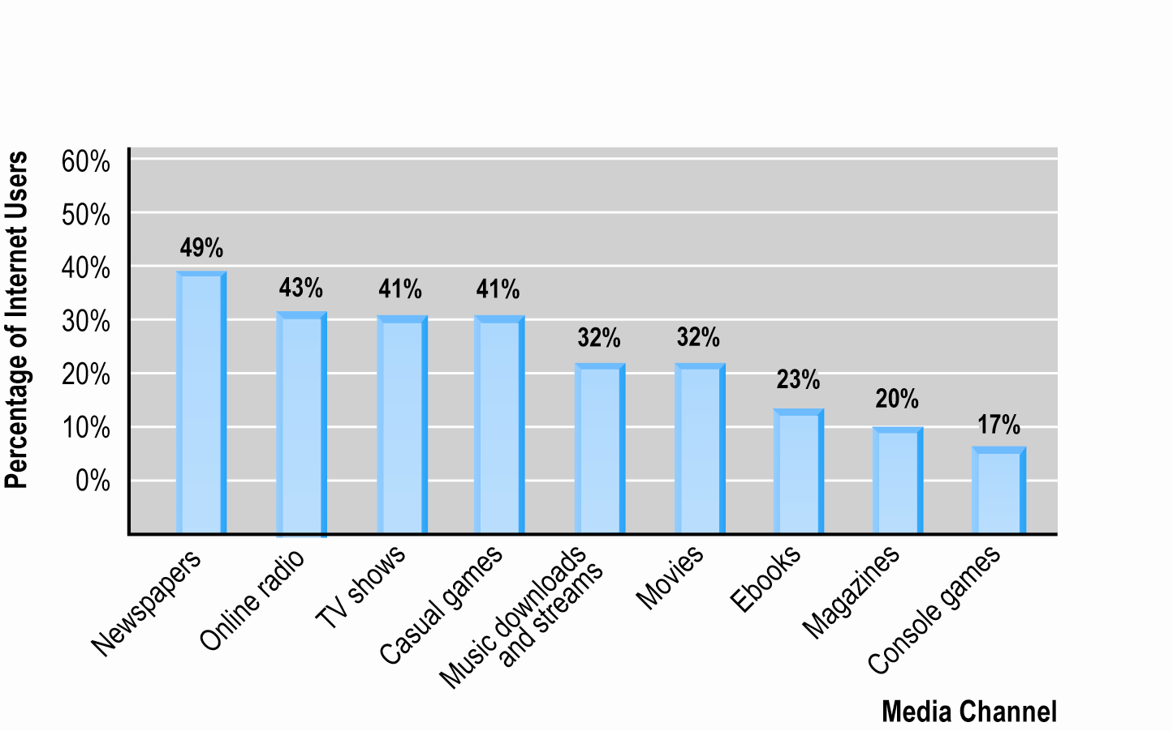
Online Content Consumption 2012
Figure 9.3, Page 353
SOURCE: Based on data from industry sources; authors’ estimates.
Copyright © 2014 Pearson Education, Inc.
Slide 9-<number>

Slide 11
Free or Fee?
Early years: Internet audience expected free content but willing to accept advertising
  Early content was low quality
With advent of high-quality content, fee models successful
  iTunes
  80 million buy from legal music sites
  YouTube cooperating with Hollywood production studios
Copyright © 2014 Pearson Education, Inc.
Slide 9-<number>

Slide 12
Digital Rights Management (DRM)
DRM: Technical and legal means to protect digital content from unlimited reproduction and distribution
Cloud-based/streaming services make traditional DRM software less necessary
Apple and Amazon use “walled garden” to prevent sharing of content from their devices
Copyright © 2014 Pearson Education, Inc.
Slide 9-<number>

Slide 13
Online Publishing Industry
$82 billion based originally in print, moving rapidly to Internet
Three segments
  Online newspapers
  E-books
  Online magazines
Copyright © 2014 Pearson Education, Inc.
Slide 9-<number>

Slide 14
Online Newspapers
Most troubled segment of publishing industry
  Failure to protect content from free distribution
  60% have reduced news staff
However:
  Online readership growing at over 10%
  Mobiles, tablets provide new avenues
  More users willing to pay for premium content
  Aggregators are recognizing need for high-quality content to distribute and use for advertisements
Copyright © 2014 Pearson Education, Inc.
Slide 9-<number>

Slide 15
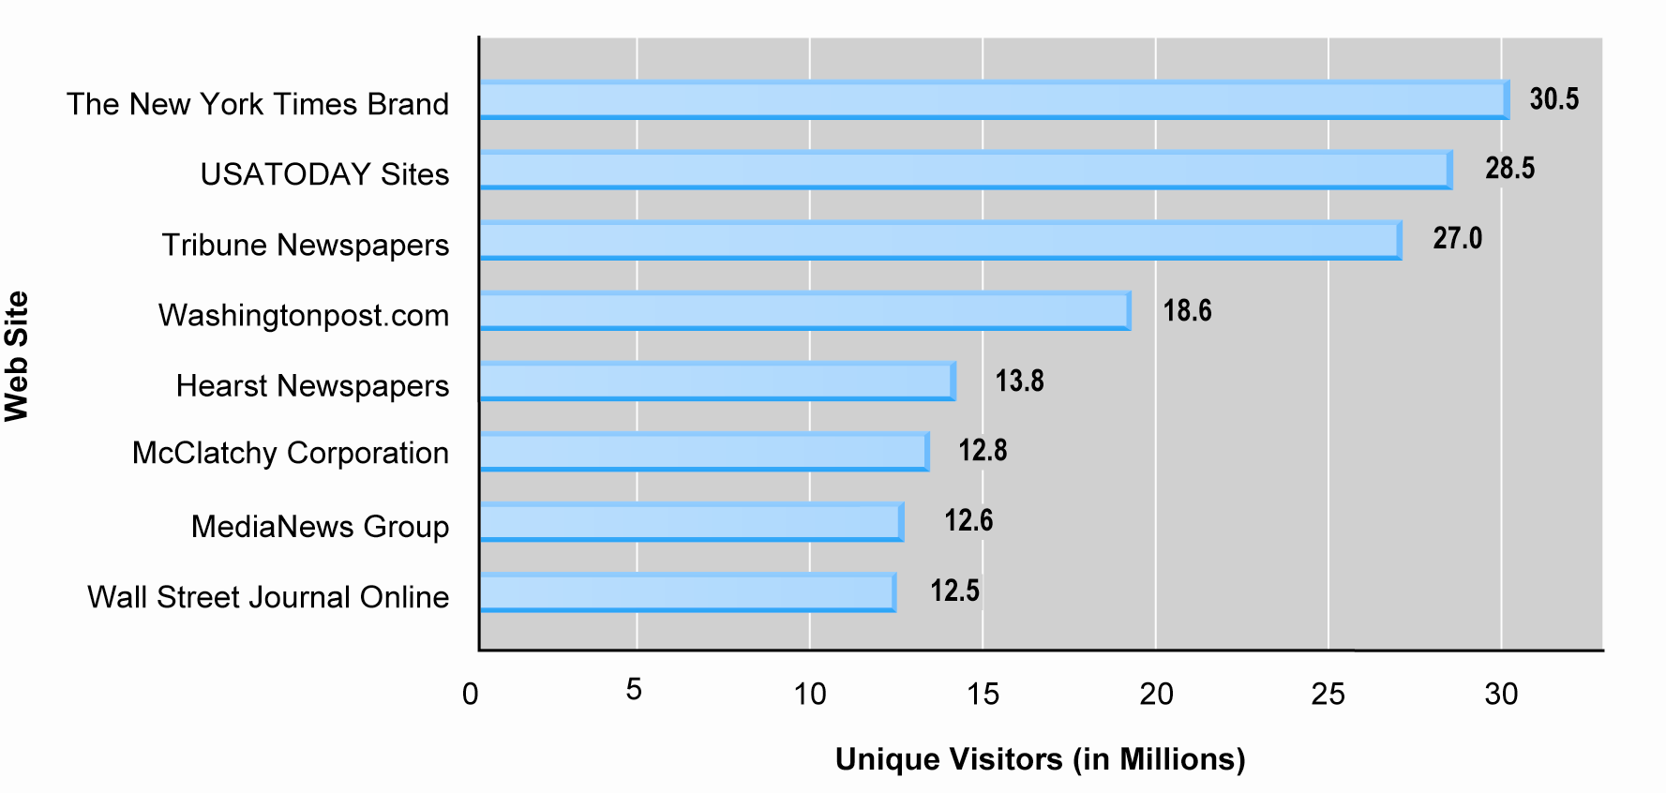
Monthly Unique Visitors at Online Newspapers
Figure 9.6, Page 357
SOURCE: Based on data from Myers, 2012
Copyright © 2014 Pearson Education, Inc.
Slide 9-<number>

Slide 16
Newspaper Business Models
Initially fee-based, then free, and now beginning a return to fee-based
Newspaper headlines are primary content on Google News, Yahoo News
New York Times now charging for premium access
Newspaper efforts to ally with Internet titans
New reader devices with reader apps
Copyright © 2014 Pearson Education, Inc.
Slide 9-<number>

Slide 17
Can Apps and Videos Save Newspapers?
Have you read a newspaper using an app?
Have you paid for any online newspaper or article? How much would you pay for a single article?
Would you prefer to watch online news videos produced by a TV station or by a newspaper such as the New York Times?
What other opportunities could help the industry recover from the decline in print sales?
Copyright © 2014 Pearson Education, Inc.
Slide 9-<number>

Slide 18
E-books and Online Publishing
E-book sales have exploded in recent years—$4.2 billion in 2012
New channel for self-publishing authors
  Amanda Hocking’s My Blood Approves (2010)
Evolution
  Project Gutenberg (1970s)
  Voyager’s books on CD (1990s)
  Adobe’s PDF format
Copyright © 2014 Pearson Education, Inc.
Slide 9-<number>

Slide 19
New Digital Ecosystems
E-book hardware, software, combined with online megastores
  Amazon Kindle: Linked to Amazon store and cloud storage
  Apple iPad: Multipurpose tablet, linked to Apple stores
Authors able to bypass traditional agent, publisher channels
DRM more effective than for music industry
Copyright © 2014 Pearson Education, Inc.
Slide 9-<number>

Slide 20
Challenges of E-book Platform
Cannibalization
  Fewer physical sales
  More e-book sales, more purchases of readers
Finding the right business model
  Wholesale model
    Retailers pay wholesale price and establish retail price
  Agency model
    Distributor as agent must charge publisher’s retail price
Converging technologies
  Interactive books
  iBook Author, iBook Textbooks
Copyright © 2014 Pearson Education, Inc.
Slide 9-<number>

Slide 21
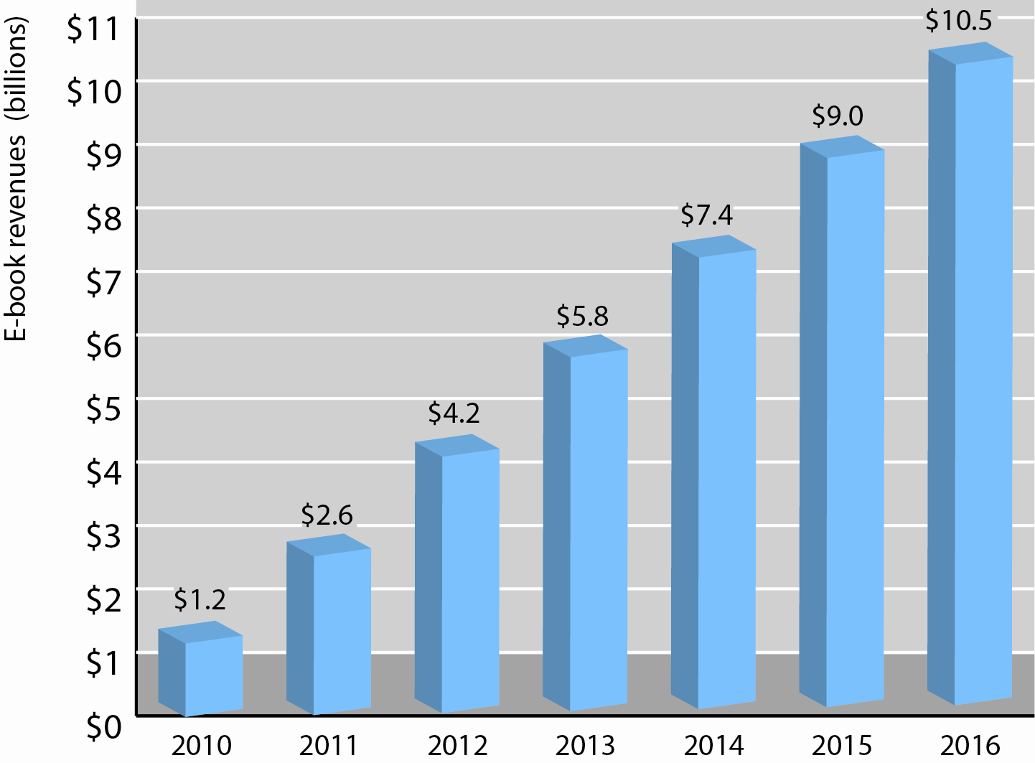
E-book Sales
Figure 9.7, Page 361
SOURCE: Based on data from eMarketer, 2012b.
Copyright © 2014 Pearson Education, Inc.
Slide 9-<number>

Slide 22
Magazines Rebound
Magazine circulation plummets 1980–2012
  Rise in online video and online news readership, and increases costs of color printing,
    2001: 22 million
    2011: 11 million
2012: Digital magazine readership doubled to 3.29 million copies
  Tablets a major factor
Magazine aggregators
Copyright © 2014 Pearson Education, Inc.
Slide 9-<number>

Slide 23
Online Entertainment Industry
Four traditional players, one newcomer
  Television
  Radio broadcasting
  Hollywood films
  Music
  Video games (new arrival)
Copyright © 2014 Pearson Education, Inc.
Slide 9-<number>

Slide 24
Online Entertainment Industry
Internet is transforming industry
  Platform development
    Smartphones, tablets, music platform
    Online streaming and cloud storage
    Social networks as distributors
  Viable business models
    Music subscription services
    Closed platforms that eliminate need for DRM
  Widespread growth of broadband
Copyright © 2014 Pearson Education, Inc.
Slide 9-<number>

Slide 25
Online Entertainment Audience Size
Online “traditional” entertainment
  Online video has largest audiences, followed by music, games
User-generated content
  Substitutes for and complements traditional commercial entertainment
  Two dimensions
    User focus
    User control
  Sites that offer high levels of both will grow
Copyright © 2014 Pearson Education, Inc.
Slide 9-<number>

Slide 26
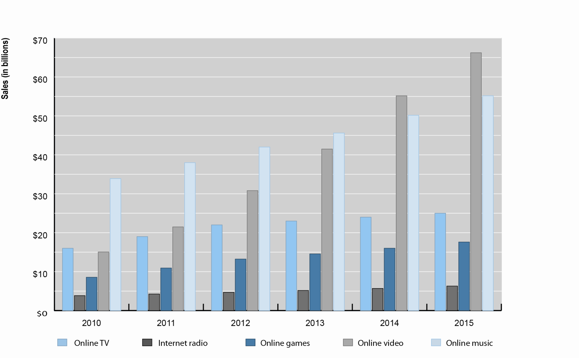
Projected Growth in Online Entertainment
Figure 9.9, Page 366
SOURCES: Based on data from industry sources; authors’ estimates.
Copyright © 2014 Pearson Education, Inc.
Slide 9-<number>

Slide 27
Television and Premium Video
TV industry transitioning to new delivery platforms
OTT: Over-the-top (Internet) delivery
Three factors in TV industry transformation
  Broadband penetration
  New mobile platforms
  Willing industry with library of high-quality content
Social network influences
Copyright © 2014 Pearson Education, Inc.
Slide 9-<number>

Slide 28
Movies
Mobile and tablet growth fueling demand for online movies
Unlike music industry, no one distributor dominates
Three types of online movie sales
  Subscription video on demand (SVOD)
  Transactional video on demand (TVOD)
  Electronic sell-through
Reduced DVD sales
Release windows system
Copyright © 2014 Pearson Education, Inc.
Slide 9-<number>

Slide 29
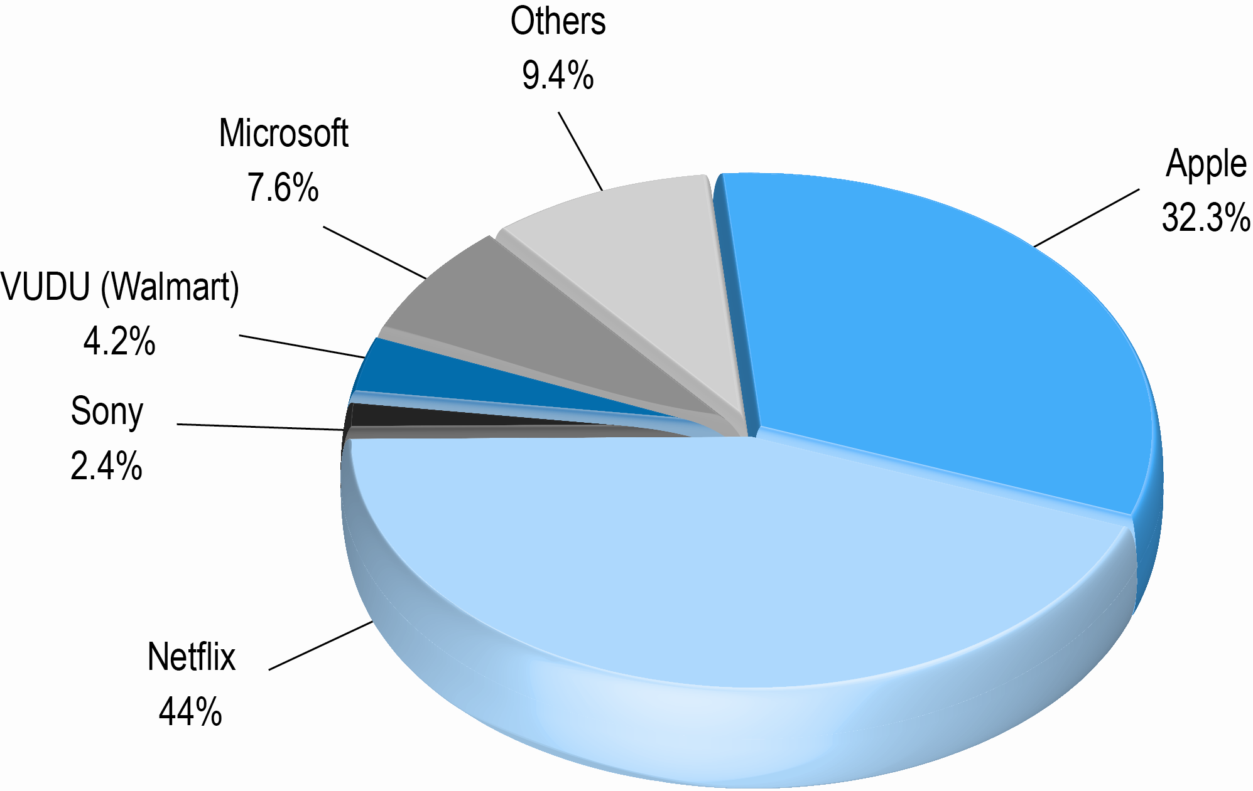
Online Movie Business
Share of Movie Revenues
Figure 9.11, page 370
Copyright © 2014 Pearson Education, Inc.
Slide 9-<number>

Slide 30
Hollywood and the Internet:
Let’s Cut a Deal
What challenges has the Internet posed to traditional Hollywood movie distribution? What is the biggest challenge?
Can Internet distribution work with the “release window” strategy?
Do you think Hollywood is doing a better job of protecting its content than the music industry?
What is the most realistic and profitable path forward for the Hollywood film industry?
Copyright © 2014 Pearson Education, Inc.
Slide 9-<number>

Slide 31
Music
Most changed of content industries
  Move from physical to digital product
  Unbundling of single songs
  Distributor market dominated by Apple
Digital revenues account for majority of all revenues (52%) for first time in 2011
Streaming services—fastest growth
  Variety of revenue models
Copyright © 2014 Pearson Education, Inc.
Slide 9-<number>

Slide 32
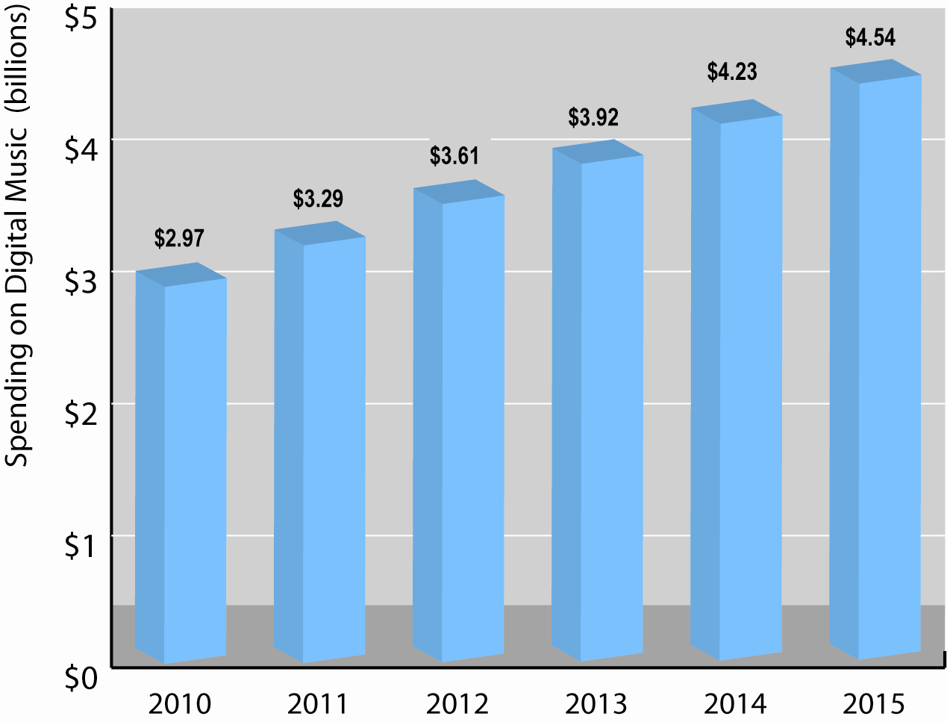
Consumer Spending on Digital Music
Figure 9.12, page 373
Copyright © 2014 Pearson Education, Inc.
Slide 9-<number>

Slide 33
Games
Online gaming has had explosive growth
Types of online gamers
  Casual
  Social
  Mobile—fastest growing market
  Console
Business models in flux
  Most online/mobile games offered for free
Copyright © 2014 Pearson Education, Inc.
Slide 9-<number>

Slide 34
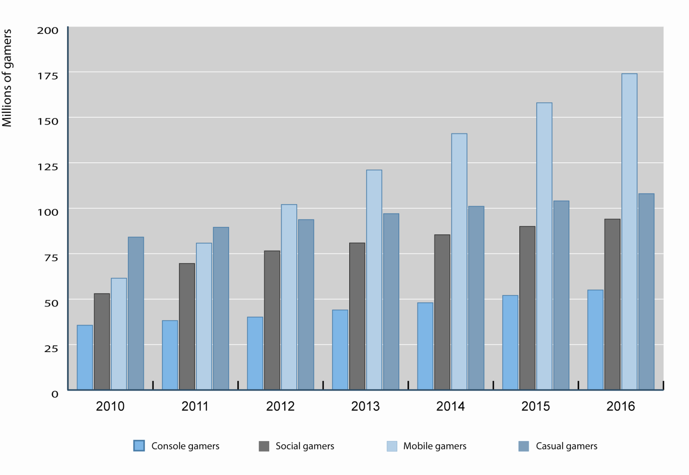
Online Gaming Audience
Figure 9.13, page 375
Copyright © 2014 Pearson Education, Inc.
Slide 9-<number>

Slide 35

Copyright © 2014 Pearson Education, Inc.
Slide 9-<number>

